Slide 1

IMU-Based ACL impairment Assessment Using Machine Learning
19101207 Kim Taehyun

Slide 2
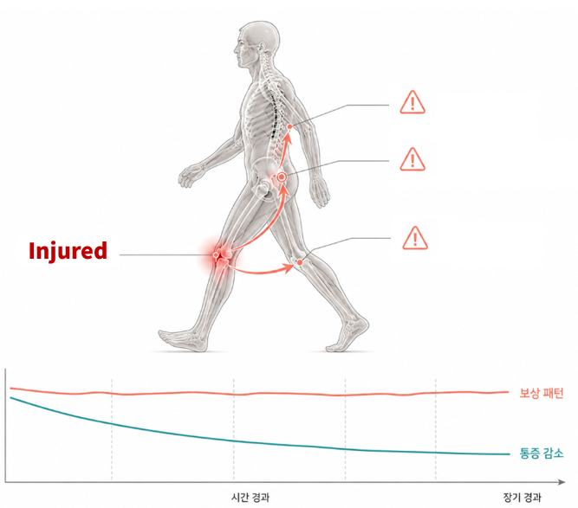
Why ACL?
250,000 [1]
Annual number of ACL injuries in the United States
Up to 25% [2]
Re-tear rate within 2 years
50% [2,3]
Incidence of osteoarthritis within 15 years
Compensation
Pain level
Time
[1] Gao & Zheng report ~250,000 ACL injuries and ~130,000 ACLR procedures/year in the US.
[2] Tan et al. report >20% reinjury and 50-80% knee OA rates after ACL injury.
[3] Hart et al. report post-traumatic knee OA in >50% within 10-20 years after ACLR.

Slide 3
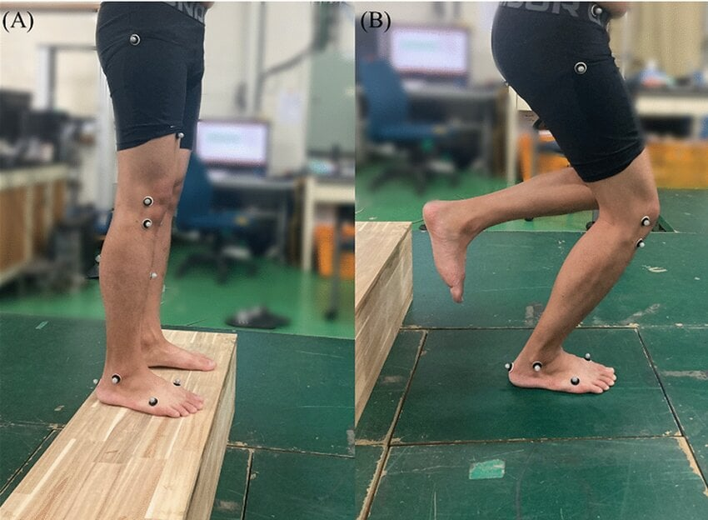
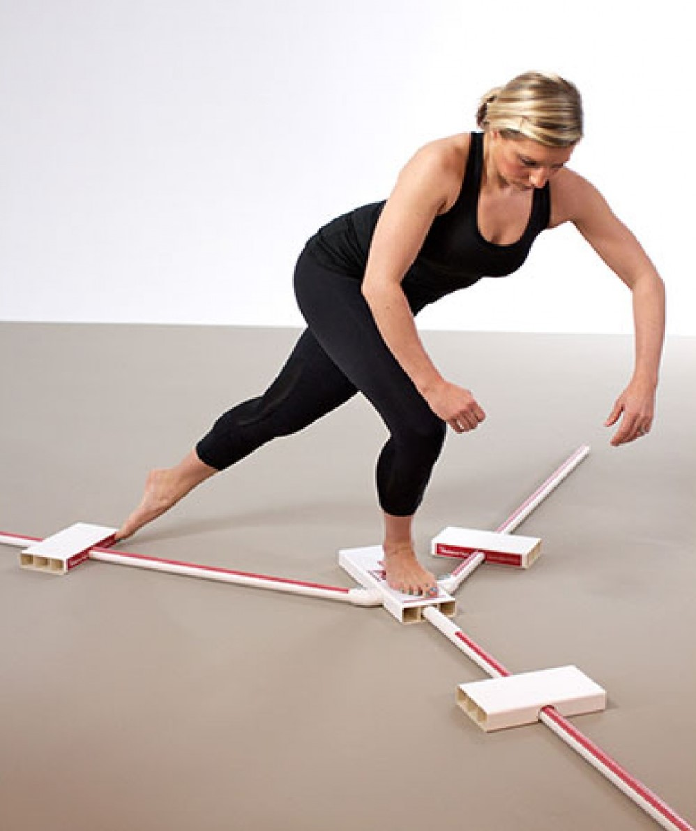
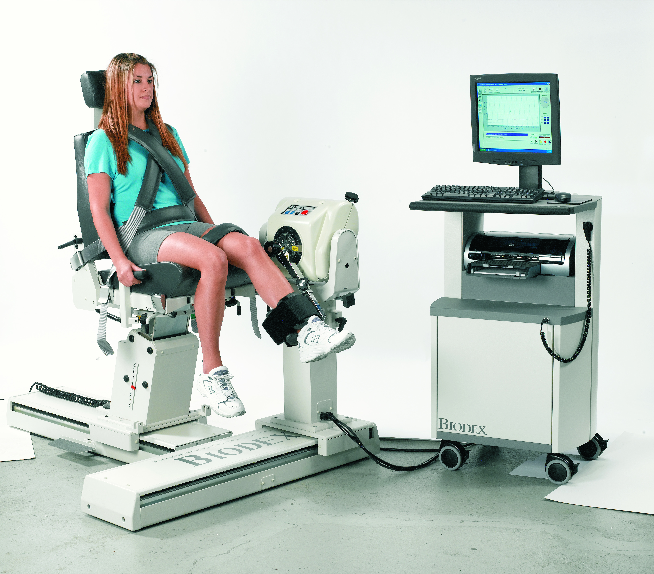
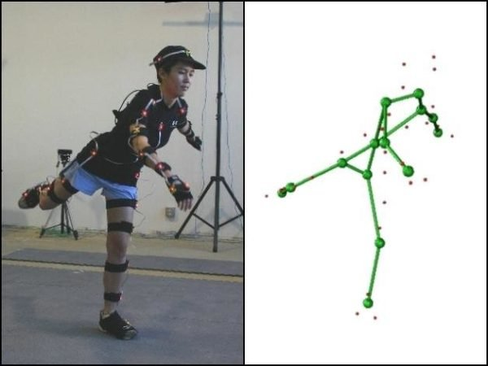
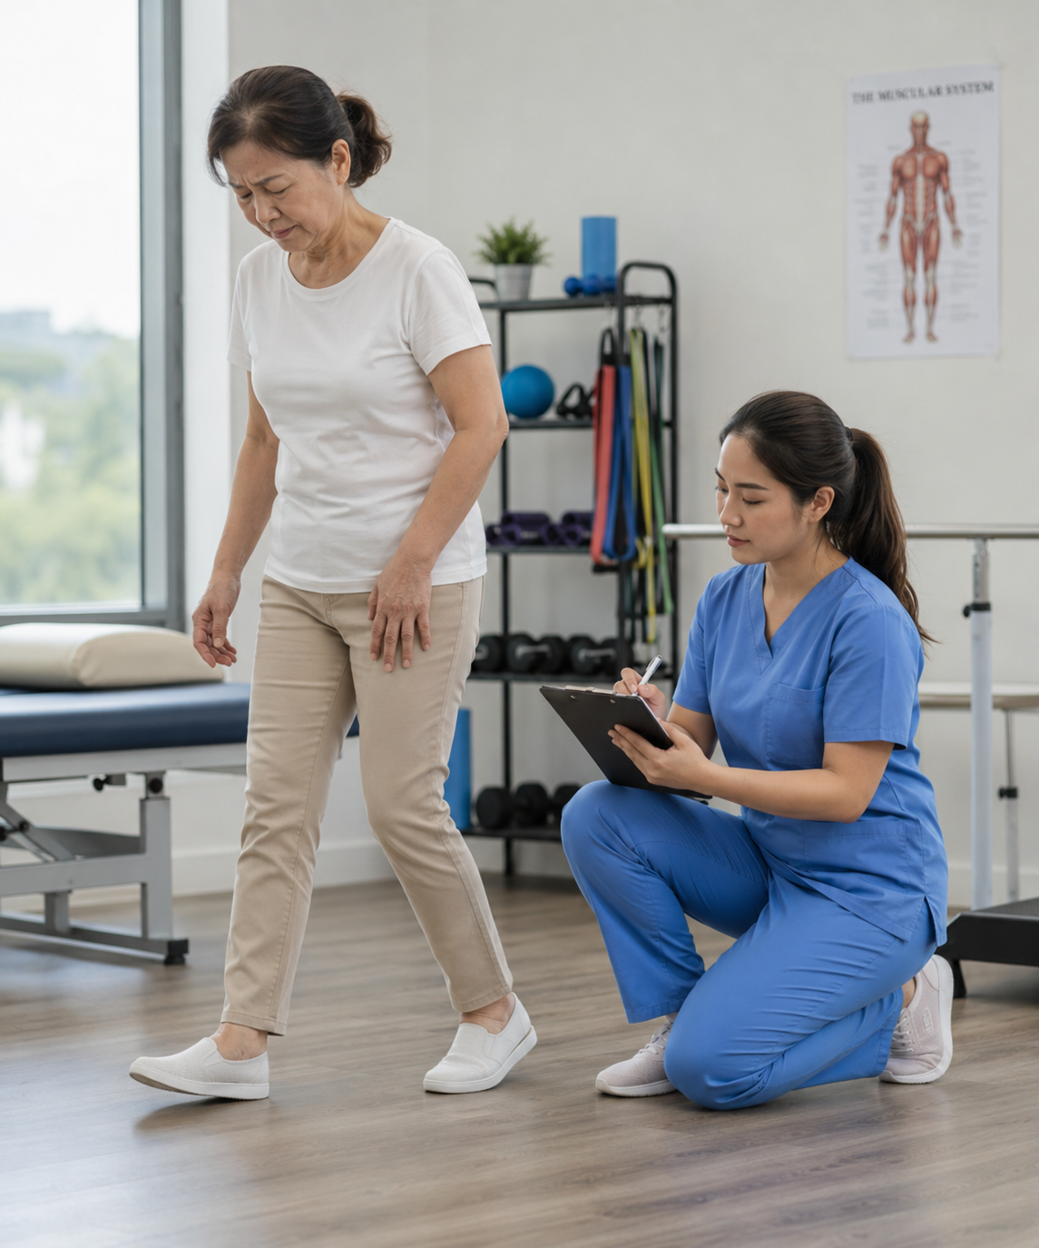
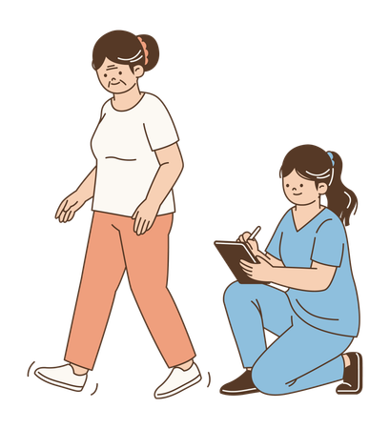
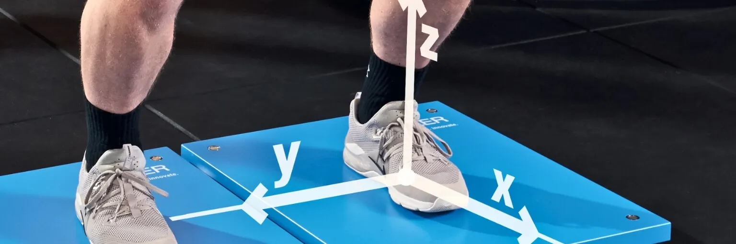
Why ACLD?
Current [7] Assessment
[7] Conventional kinetic assessment requires complex, expensive systems and is limited to laboratory settings.

Slide 4
Solution
What we need!
Gold Standard [7]
Reliability
Clinical [7] Assessment
COST
[7] Laboratory-based systems remain the conventional reference for kinetic assessment but limit routine clinical access.

Slide 5
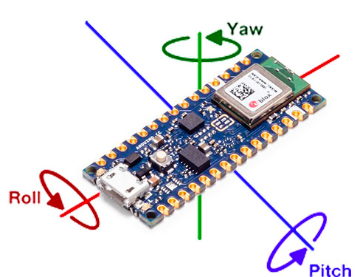
Solution
IMU [4]
Cost
Size
Easy
GAIT
6,000–12,000 [5] steps
Enables continuous [2,4] monitoring in daily life Low intensity
Feasible for patients with minimal burden
[4] COMPWALK-ACL describes portable, cost-effective IMU gait assessment outside the lab across slow/normal/fast speeds.
[5] Post-ACLR daily-step tertiles ranged from 3,326-12,680 steps/day in Lisee et al.

Slide 6
Limitations of previous studies
Single-speed [4] gait assessment
Use Only scalar [3,6] features
High-cost [2,7] laboratory environment
[4] Speed strongly modulates joint kinematics, motivating multi-speed assessment.
[6] Waveform analysis evaluates the entire stance phase instead of only discrete peak outcomes.

Slide 7
Our contribution
Early Rehabilitation
IMU- and ML-based Impairment Assessment
Multi-speed
Feasibility of Quantifying Assessment Outcomes

Slide 8
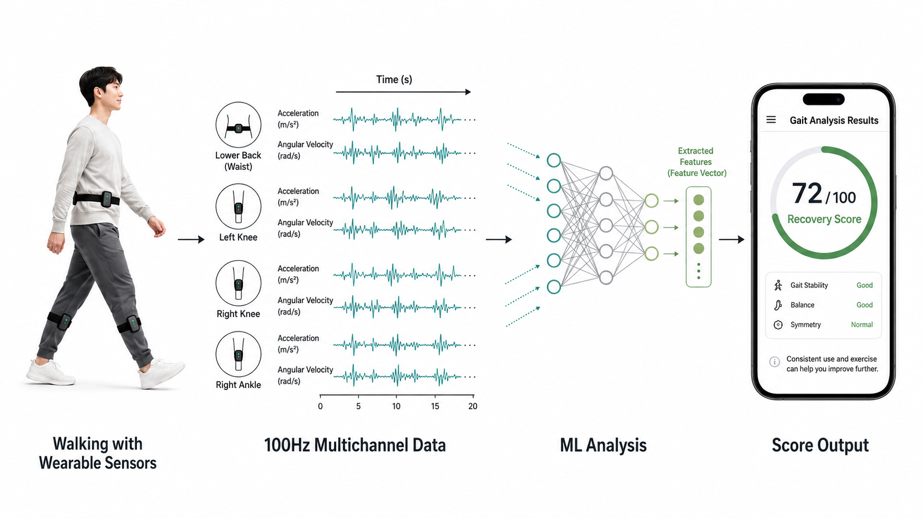
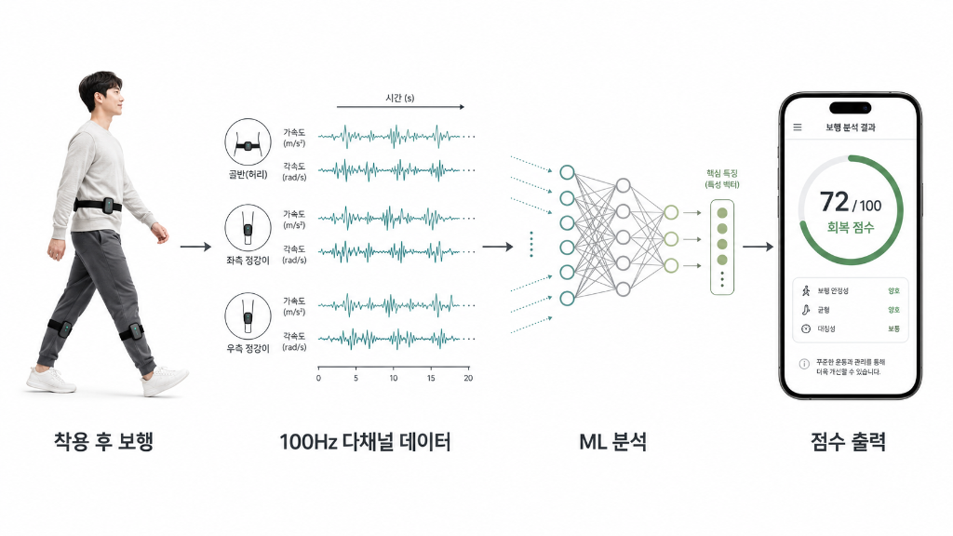
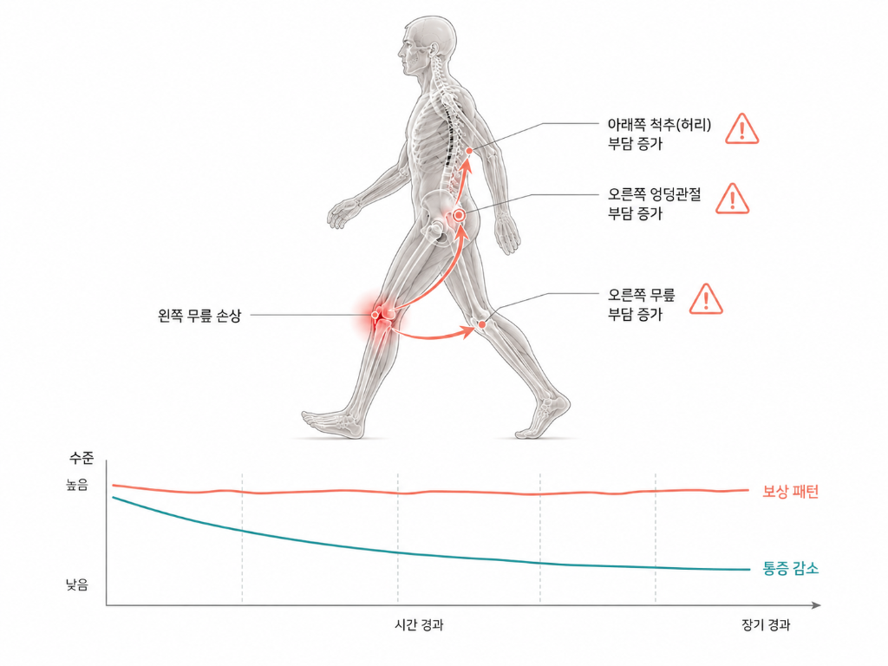

Slide 9
method
Data Preprocessing
Waveform Analysis
Impairment Scoring
SHAP Interpreting
Data inspection and normalization, peak detection
Global statistical analysis using SPM1D
Point Metric Analysis
Looking at biomechanical metrics and specific time point
Clustering, distance
Interpretation of ML using SHAP

Slide 10
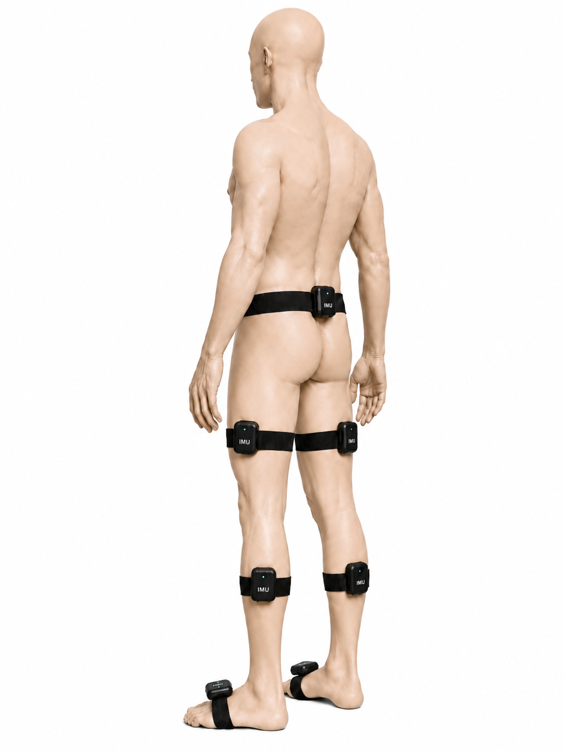
Data [4]
Slow Normal Fast
[4] COMPWALK-ACL collected overground gait at self-selected slow, normal, and fast speeds.

Slide 11
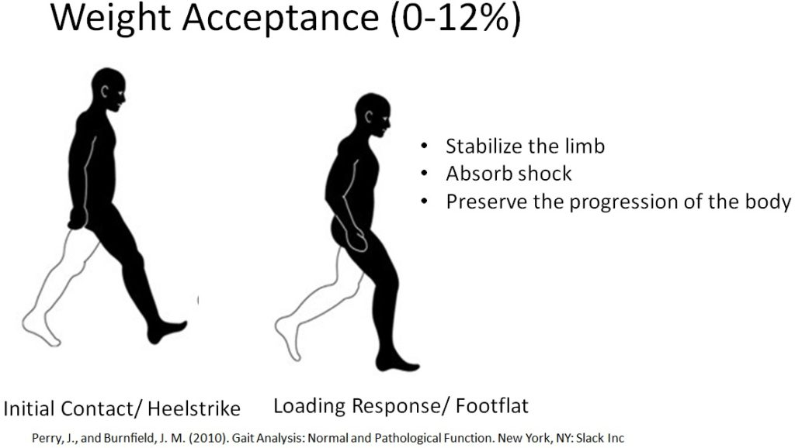
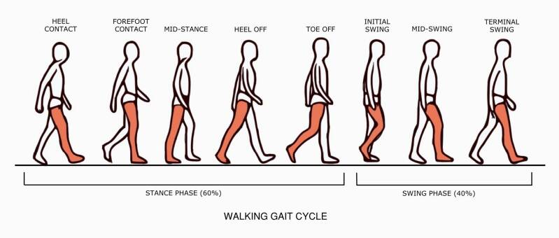
Biomechanical metrics [3]
STANCE PHASE
SWING PHASE
[3] ACLR gait reviews focus on knee kinematics and joint moments during level walking.

Slide 12
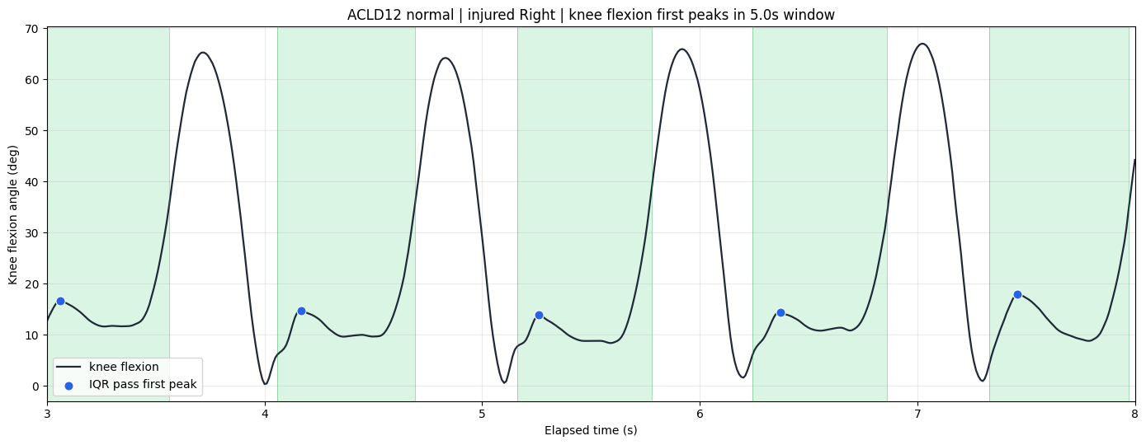
Biomechanical Features
Stance phase features
Peak / min / ROM / [3] IC_angle / peak_timing
Limb Symmetry Index [3]
( Injured / Contralateral ) X 100
Knee flexion angle
[3] Peak, ROM, and side-to-side variables are common discrete gait metrics in ACLR literature.
Time (s)

Slide 13
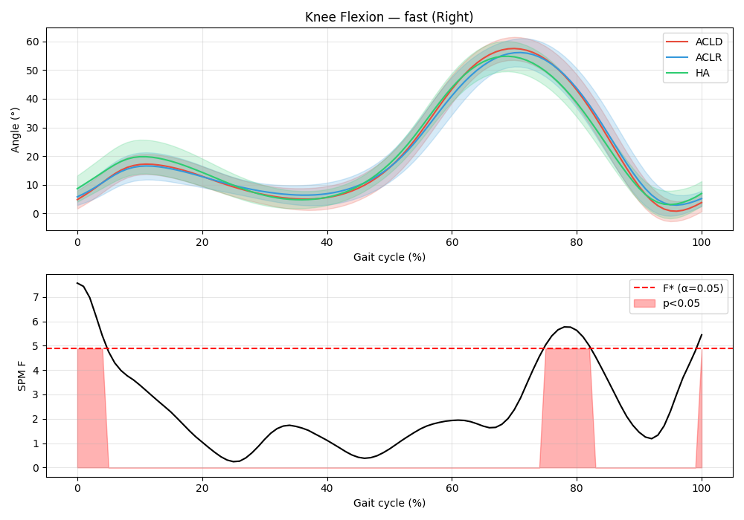
analysis
Point metric
Waveform, SPM1D [6]
Scalar feature table
Shapiro-Wilk
Levene
Non-noraml
Normal + Equal var.
Normal + Unequal var.
Kruskal-Wallis
One-way ANOVA
Welch ANOVA
FDR-BH correction
Effect size [6]
Downstream
[6] Bilateral waveform analysis used functional models across stance and reported significant waveform regions/effects.

Slide 14
Results summary
Significant features by speed
Significant features by cluster

Slide 15
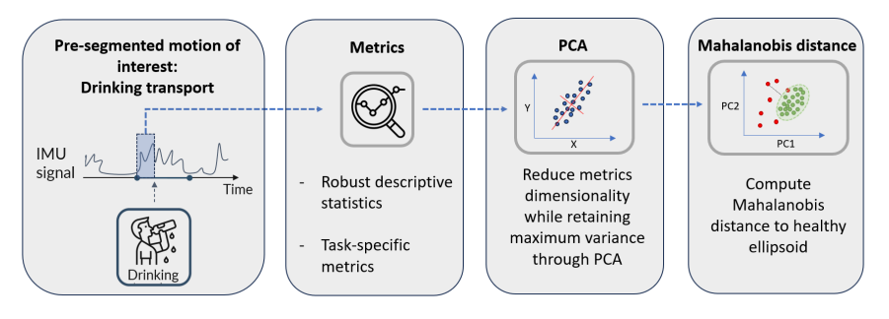
To do
Scoring Framework
Interpretation Using SHAP
SHAP was used to interpret the model’s predictions and improve explainability, which is crucial in medical applications. [8]
[8] Kokkotis et al. used SHAP-based explainability to rank gait biomechanical parameters in ACL injury classification.

Slide 16

Question?

Slide 17

Thank you for listening!

Slide 18



Why ML? [8]
Input
Model
Output
Why ML?
[8] Explainable ML can identify biomechanical parameters that contribute to ACL injury classification.

Slide 19
References
[1] Gao, B., & Zheng, N. (2014). Progressive Changes in Walking Kinematics and Kinetics After Anterior Cruciate Ligament Injury and Reconstruction: A Review and Meta-Analysis.
[2] Tan, T., Gatti, A. A., Fan, B., et al. (2022). Towards Out-of-Lab Anterior Cruciate Ligament Injury Prevention and Rehabilitation Assessment: A Review of Portable Sensing Approaches.
[3] Hart, H. F., Culvenor, A. G., Collins, N. J., et al. (2016). Knee kinematics and joint moments during gait following anterior cruciate ligament reconstruction: A systematic review and meta-analysis.
[4] Yona, T., Peskin, B., & Fischer, A. (2026). The COMPWALK-ACL: A Dataset of Multi-pace IMU Gait Kinematics in Adolescents, Adults, and ACL Injured Patients.

Slide 20
References
[5] Lisee, C., Davis-Wilson, H., Evans-Pickett, A., et al. (2022). Linking Gait Biomechanics and Daily Steps Post ACL-Reconstruction.
[6] Buttner, C., Lisee, C., Bjornsen, E., et al. (2025). Bilateral waveform analysis of gait biomechanics presurgery to 12 months following ACL reconstruction compared to controls.
[7] Krishnakumar, S., van Beijnum, B.-J. F., Baten, C. T. M., et al. (2024). Estimation of Kinetics Using IMUs to Monitor and Aid in Clinical Decision-Making during ACL Rehabilitation: A Systematic Review.
[8] Kokkotis, C., Moustakidis, S., Tsatalas, T., et al. (2022). Leveraging explainable machine learning to identify gait biomechanical parameters associated with anterior cruciate ligament injury.

